Slide 1
Controlling cameras and motors with android phone
&
KOGAKUIN-University Supervisor: M. KANAMARU Takashi
ESIEE-Paris Students: M. MARLEIX Mathieu Ms. VATON Doris
Internship :
May 2012 – July 2012

Slide 2
Plan of The Presentation
What is Shaipicku?
Recognition : Color & Shape
Arm : Controlled via Bluetooth
Configuration of The Board Game
How to Play Shaipicku?
Work’s Planification
Conclusion
Demonstration (Video)
SHAIPICKU / May 2012 - July 2012
MARLEIX Mathieu – VATON Doris
&

Slide 3
What is « Shaipicku »?
Game of Cubes
Two Cameras to Obtain a Full Image of the Board Game via WIFI
Five Motors to Have a Moving Arm to Pick Up the Cubes Controlled by Bluetooth
Four Modes to Play : « Color », « Shape », « Color & Shape » and « Pile-Up »
Two Methods to Play : « Button » or « Drawing »
SHAIPICKU / May 2012 - July 2012
MARLEIX Mathieu – VATON Doris
&

Slide 4
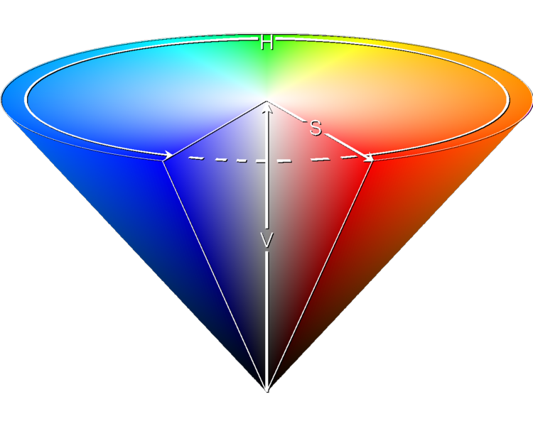
Recognition : Color & Shape
Software : Android 2.3.3 with The Library Open CV
Color’s Recognition
→ Why Color’s Recognition?
Shape Recognition Required the Isolation of Objects on the Camera’s Image
→ How is it performed?
Use OpenCV HSV Color Space
Closing to Reduce the Noise of the Image
S
H
V
H = HUE ⬅➔ Color
S = SATURATION ⬅➔ Color’s Intensity
V = VALUE ⬅➔ Color’s Brightness
BEFORE
AFTER
Closing
SHAIPICKU / May 2012 - July 2012
MARLEIX Mathieu – VATON Doris
&

Slide 5
Recognition : Color & Shape
Form’s Recognition
→ After Color’s Recognition :
Object’s Color is White and Surroundings are Black
→ First Step :
Extracting the Edges
→ Second Step :
Calculation of the Following Ratio
Metric_shape = Shape_Area * C_{Shape}/(Shape_Perimeter)²
Perfect Shape ⬅➔ Metric_Shape = 1
Deformed Shape⬅➔ Metric_Shape < 1
Color
Edges
With
C_{Circle} = 4*π C_{Square} = 16 C_{triangle} = 18
SHAIPICKU / May 2012 - July 2012
MARLEIX Mathieu – VATON Doris
&

Slide 6
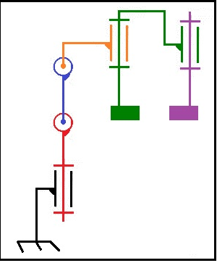
Arm : Controlled via Bluetooth
Structure of the Arm
5 Motors for The Arm’s Movements
Right and Letf Movements -Motor 1
Up and Down Movements -Motor 2 & Motor 3 - Two Motors Increase the Scope
Pliers -Motor 4: Orientation of Pliers -Motor 5: Opening & Closing
The Pliers
Support
Motor 1
Motor 2
Motor 3
Motor 4
Motor 5
Arm: Kinematic Diagram
SHAIPICKU / May 2012 - July 2012
MARLEIX Mathieu – VATON Doris
&

Slide 7
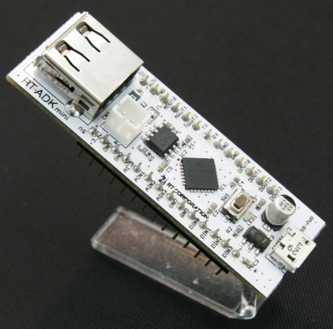
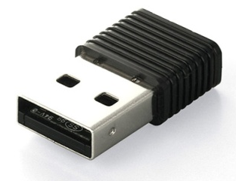
Arm : Controlled via Bluetooth
The Control of The Arm
PWM Needed to Control the DC Motors of The Arm
➔ Use of a PIC to Have 5 PWM, One for Each Motor
PIC24F on RT-ADK Mini Card
Link Between the Phone and the Arm : Bluetooth Connexion
➔ Bluetooth Device Added to the RT-ADK Card
Bluetooth Connexion
Bluetooth Transmiter
SHAIPICKU / May 2012 - July 2012
MARLEIX Mathieu – VATON Doris
&

Slide 8
Configuration of the Board Game
Figure 1
Cube 1
Robot Arm
Cube 2
Figure 2
Cube 3
Figure 3
Camera 1
Camera 2
Game Board : Top View
SHAIPICKU / May 2012 - July 2012
MARLEIX Mathieu – VATON Doris
&

Slide 9
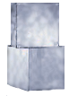
How to Play « Shaipicku »?
Same Shape for Cube & Figure
Same Color for Cube & Figure
Move To
Move To
Cube
Figure
Cube
Figure
Mode : Shape
Mode : Color
Choice of The User
Order of The Cubes
Same Shape & Color for Cube & Figure
1
3
2
2
Move To
Pile-Up
Mode : Shape & Color
Cube
Figure
Mode : Pile-Up
3
1
SHAIPICKU / May 2012 - July 2012
MARLEIX Mathieu – VATON Doris
&

Slide 10
Work’s Planification
SHAIPICKU / May 2012 - July 2012
MARLEIX Mathieu – VATON Doris
&

Slide 11
Conclusion
SHAIPICKU / May 2012 - July 2012
MARLEIX Mathieu – VATON Doris
&

Slide 12
Demonstration
Video
SHAIPICKU / May 2012 - July 2012
MARLEIX Mathieu – VATON Doris
&

Slide 13
Questions ?
KOGAKUIN-University Supervisor: M. KANAMARU Takashi
&
ESIEE-Paris Students: M. MARLEIX Mathieu Ms. VATON Doris
Shaipicku
Internship :
May 2012 – July 2012

